Slide 1
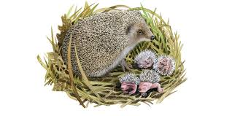
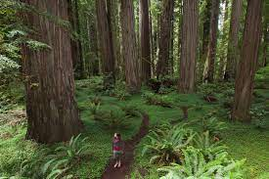
As communicators we will…
Be learning a word of the day and building on our vocabulary.
We will make up simple stories using might writer
Talk about celebrations such as fireworks, Remembrance day and Christmas
As Scientists we will...
Early years foundation stage | Suggested Activities | Early learning goal | Assessment
Talk about the signs of autumn and the seasons Look at animals that live in the woods Explore different animal habitats Introduce vocabulary nocturnal and hibernation | Go on autumn walks and notice changes in the environment Make habitats for woodland animals Label animal features | Understand some important processes and changes in the natural world around them, including the seasons and changing states of matter Explore the natural world around them, making observations and drawing pictures of animals and plants. | Self marking Peer marking
Trips/Visitors
Diwali workshop
Panto
In the woods
As Healthy Movers we will ….
Children know the importance of good health of physical exercise and a healthy diet.
Children show good control and co-ordination.
Children will learn to move their bodies to music moving their bodies in different ways through dance
Join in with the dough disco to strengthen hand muscles.
As historians we will..
Talk about past celebrations and how different cultures have celebrated festivals
As Readers and Writers we will...
Early years foundation stage | Suggested Activities | Early Learning Goals | Assessment
Form lower- case and capital letters correctly beginning to write cvc words Read individual letters by saying the sounds for them Understand how a story is structured Retell stories | Listen to stories about the woods . Sequence story and talk about the characters Listen to ABC songs. Continue phase 2 phonics using Monster Phonics Encourage writing for a purpose. Encourage mark making through Role play Make story maps Act out stories Write Christmas letters an cards | Demonstrate understanding of what has been read to them by retelling stories and narratives using their own words and recently introduced vocabulary Write recognisable letters, most of which are correctly formed | Self marking Peer marking Teacher to annotate the learning objectives they have achieved.
As kind considerate people we…
Build constructive and respectful relationships
Learn how to deal with our emotions and situations which make us upset
Listen to how people our feeling and how we can help them
Fantastic Finish
Have a Christmas party

Slide 2
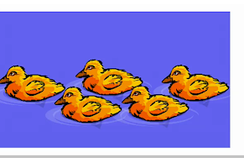
As Artists we will...
Early years foundation stage | Suggested Activities | Link | Assessment
Select tools and techniques to assemble materials Explore different materials to make pictures | Owl masks Firework pictures Rangoli pictures Poppies Christmas decoration | History PHSE RE | Self marking Peer marking Teacher to annotate the learning objectives they have achieved.
As Mathematicians we will...
Early years foundation stage | Suggested Activities | Early Learning goal.
Looks at circles and triangles Understand and use positional language Represent numbers 1-5 One more and one less Shapes with 4 sides time | Counting games Shape hunt Addition and subtraction stories Sequencing daily routine Shape printing Wrapping presents/ boxes | Have a deep understanding of number to 10, including the composition of each number Subitise (recognise quantities without counting) up to 5;
As Computing Scientists we will...
Early years foundation stage | Suggested Activities | Links | Assessment
Technology: Select and use technology for particular purpose.. | Use programmes on the class IPad and interactive white board. Update our Class Dojo emoji. Learn about E-safety. | Art | Self marking Peer marking Teacher to annotate the learning objectives they have achieved.
As Musicians we will...
Early years foundation stage | Suggested Activities | Early learning Goal.
Explore and engage in music making and dance, performing solo and in groups | Experiment with music and dancing through Write Dance. Dance PE Perform our own stories Nativity performance Sing Christmas songs | Sing a range of well-known nursery rhymes and songs.
As Designers we will...
Early years foundation stage | Suggested Activities | Early Learning Goal.
Use different materials to make a model Develop their small motor skills so that they can use a range of tools competently safely and confidently | Animal habitat Make an animal mask Pinecone Hedgehog | Safely use and explore a variety of materials, tools and techniques, experimenting with colour, design, texture, form and function

