Slide 1
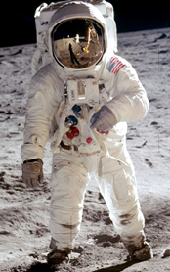
As Scientists we will…
National Curriculum | End points | Links | Assessment
Pupils should be taught to: ▪ distinguish between an object and the material from which it is made ▪ identify and name a variety of everyday materials, including wood, plastic, glass, metal, water, and rock ▪ describe the simple physical properties of a variety of everyday materials ▪ compare and group together a variety of everyday materials on the basis of their simple physical properties. | Materials Explore different materials. Look at objects made from different materials. Recognise that paper can be made into different things. Recognise that fibres that make fabric can be woven or knitted. Investigate objects made from several materials. Investigate some material are suitable for making some objects. | Maths ICT Art | Pictures and labelling Through spoken word- questions and answers
Stunning Start
Space workshop.
As musicians we will..
Pupils should be taught to: use their voices expressively and creatively by singing songs and speaking chants and rhymes
play tuned and un-tuned instruments musically
listen with concentration and understanding to a range of high-quality live and recorded music
experiment with, create, select and combine sounds using the inter-related dimensions of music.
As Respectful Citizens we will…
Learn about relationships and feelings and emotions
and valuing differences
Learn about who is special to us.
Discuss that family is one of the
groups we belong to, as
well as, for example, school,
friends, clubs.
We will learn about the Jewish religion and what do they believe in, what might be found in a Jewish home.
Term 4
One small step for man
Reading | Writing/Grammar | Links | Assessment
Apply phonic knowledge and skills to decode words. Read common exception words Develop pleasure in reading, motivation to read, vocabulary and understanding by discussing word meanings, linking new meanings to those already known Answer questions in discussion with the teacher and make simple inferences Book corner The Three Little Pigs The Man on the Moon The Owl Who was Afraid of the Dark Wolves The Chickens build a Wall The Three Little Kittens (poem) Genre Fiction- openings and endings Non-fiction – recount in the form of a letter. | Recognising ‘but’ Using ‘but Recognising ‘or’ Using ‘or’ Using ‘and’, ‘but’ and ‘or’ Capital letters to start sentence Capital letters for Dates Capital letters for places Consolidating capital letters Handwriting Sit correctly and hold a pencil correctly. Understand which letters belong to which handwriting ‘families’ (ie letters that are formed in similar ways) and to practise these. Story time text The True Story of the Three little Pigs - Sceince Avocado baby - PSHE Can’t You Sleep Little Bear - PSHE Voices in the Park - PSHE Three Brave Women - PSHE Wander in the Wild Wood | ICT Science PSHE Geography | Self/peer assessment Finished piece of writing – fun write.
Fantastic Finish
To go on an expedition around the village
Trips/visitors
Teddy Bears picnic
Greenwich Observatory zoom workshop TBC

Slide 2
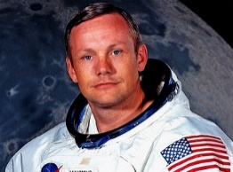
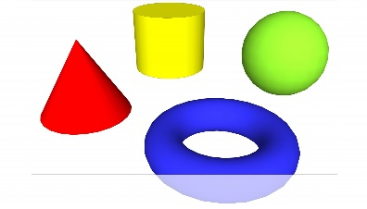
As Historians we will …
Investigate | End points | Links | Assessment
Places, patterns and geographical vocabulary. | Neil Armstrong and the Moon Landing Observe or handle evidence to ask questions and find answers to questions about the past. Ask questions such as: What was it like for people? What happened? How long ago? Use artefacts, pictures, stories, online sources and databases to find out about the past. Identify some of the different ways the past has been represented. Describe historical events. Describe significant people from the past. Recognise that there are reasons why people in the past acted as they did. | Science | Class discussion Peer/self assessment Plickers questionnaire
As Designers we will…
Respond to ideas | End points | Link | Assessment
Respond to ideas and starting points. Explore ideas and collect visual information. Explore different methods and materials as ideas develop. | Levers – make a litter picker Create products using levers. Use scientific knowledge of the transference of forces to choose appropriate mechanisms for a lever. | Sci ICT | Self/peer assessment
As technicians we will…
National Curriculum | End points | Links | Assessment
Use a range of applications and devices in order to communicate ideas, work and messages. | To introduce e-books and the 2Create a Story tool. • To add animation to a story. • To add sound to a story, including voice recording and music the children have composed. • To work on a more complex story, including adding backgrounds and copying and pasting pages. | PSHE | Peer-evaluation, using the specified success criteria
As mathematicians we will…
National Curriculum | End points | Assessment
Recognise and name common 2-D and 3-D shapes, including: 2-D shapes [for example, rectangles (including squares), circles and triangles]; 3-D shapes [for example, cuboids. Count to and across 100, forwards and backwards, beginning with zero or 1, or from any given number • Identify and represent numbers using objects and pictorial representations including the number line, and use the language of: equal to, more than, less than (fewer), most, least. | Shape Recognise and name 3-D shapes Sort 3-D shapes Recognise and name 2-D shapes Sort 2-D shapes Patterns with 2-D and 3-D shapes Place value within 20 Count within 20 Understand 10 Understand 11, 12 and 13 Understand 14, 15 and 16 Understand 17, 18 and 19 Understand 20 1 more and 1 less The number line to 20 Use a number line to 20 Estimate on a number line to 20 Compare numbers to 20 Order numbers to 20 | Assessment paper at the end Ongoing class-based assessment
PE
National Curriculum | End points | Link | Assessment
Pupils should develop fundamental movement skills, become increasingly competent and confident and access a broad range of opportunities to extend their agility, balance and coordination, individually and with others. They should be able to engage in competitive (both against self and against others) and co-operative physical activities, in a range of increasingly challenging situations. | Gymnastics Copy and remember actions. Move with some control and awareness of space .Link two or more actions to make a sequence. Hold a position whilst balancing on different points of the body. •rolling – egg roll, log roll, rock to stand and forward roll• jumping – straight, tuck and star jump •weight on hands – bunny hops | Sci PSHE | Self/peer assessment Team work

