Slide 1
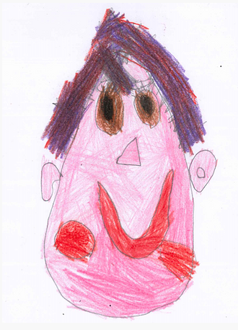
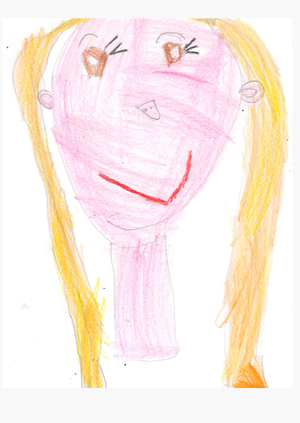
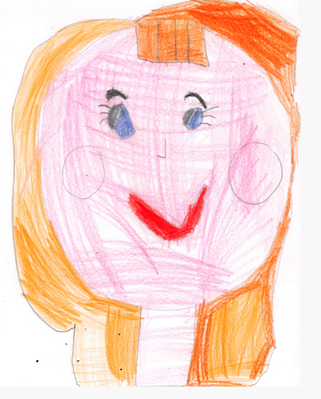
Welcome to Rodmersham School
This leaflet has been given to you to make sure you understand what is expected of you while visiting our school.
It is the responsibility of everyone (including visitors) to keep children safe.
If you are worried about the safety of any young person in our school, you must report this to one of the contacts on the back of this leaflet.
We hope you enjoy your visit and we thank you for your cooperation.
Security
All visitors must report to the school reception office where they must sign in on the visitor management system. All visitors must wear their visitor badge at all times.
First Aid
If you require first aid or you feel unwell then please contact the school office who will fetch one of our registered first aiders to assist you.
Accidents
Any illness, injury or accident must be reported to the school office.
Mrs McMullon | Mrs Williams | Mrs Cooper
Safeguarding Lead | Deputy Safeguarding Officer | Deputy Safeguarding Officer
What to do if you are worried about a child or have a concern 1. When talking to the child, do not ask leading questions. 2. If the information that a child gives you indicates a substantial concern or an allegation, do not continue to probe. Should the police need to become involved, asking too many questions can taint the investigation they will need to carry out. Pass the information on to the appropriate member of staff. 3. Do not promise to keep any of the child’s responses secret. If a child asks you to do this, reply that you cannot promise to do this because you might need to tell someone else you can help. 4. Report your concern directly to Nicky McMullon, or if she is not available, to one of the other designated safeguarding officers. If none of these individuals are available, report your concern to any other senior member of staff. 5. As soon as you have reported your concern, your responsibility is fulfilled and the safeguarding team will take over. You may be given brief details of follow up action, though please understand that where information is sensitive it may not be able to be communicated for reasons of confidentiality. 6. If you have a concern about a member of staff, then this should also be reported to the Head Teacher or Senior Teacher, Maria Cooper. For more details, please see our full Child Protection and safeguarding policy. |  | What to do if you are worried about a child or have a concern 1. When talking to the child, do not ask leading questions. 2. If the information that a child gives you indicates a substantial concern or an allegation, do not continue to probe. Should the police need to become involved, asking too many questions can taint the investigation they will need to carry out. Pass the information on to the appropriate member of staff. 3. Do not promise to keep any of the child’s responses secret. If a child asks you to do this, reply that you cannot promise to do this because you might need to tell someone else you can help. 4. Fill out a cause for concern form (available from the school office). Report your concern directly to Bernie Delaney, or if she is not available, to one of the other designated safeguarding officers (see front page). If none of these individuals are available, report your concern to any other senior member of staff. 5. As soon as you have reported your concern, your responsibility is fulfilled and the safeguarding team will take over. You may be given brief details of follow up action, though please understand that where information is sensitive it may not be able to be communicated for reasons of confidentiality. 6. If you have a concern about a member of staff, then this should also be reported to the Head of School or Deputy Head teacher. For more details, please see our full Child Protection and safeguarding policy.

Slide 2
Wi-Fi Acceptable Use
Use of Mobile Devices and Smart Technology
I will respect system security; I will not disclose any password or security information that is given to me. To prevent unauthorised access, I will not leave any information system unattended without first logging out or locking my login as appropriate.
I will not attempt to bypass any of the school security and filtering systems or download any unauthorised software or applications.
My use of school Wi-Fi will be safe and responsible and will always be in accordance with the school AUP and the law including copyright and intellectual property rights. This includes the use of email, text, social media, social networking, gaming, web publications and any other devices or websites.
I will not upload, download, access or forward any material which is illegal or inappropriate or may cause harm, distress or offence to any other person, or anything which could bring the school into disrepute.
I will report any online safety concerns, filtering breaches or receipt of inappropriate materials to the Designated Safeguarding Lead (Nicky McMullon) as soon as possible.
If I have any queries or questions regarding safe behaviour online, I will discuss them with Designated Safeguarding Lead (Nicky McMullon).
I understand that my use of the school WI-Fi may be monitored and recorded to ensure policy compliance in accordance with privacy and data protection legislation. If the school suspects that unauthorised and/or inappropriate use or unacceptable or inappropriate behaviour may be taking place, then the school may terminate or restrict usage. If the school suspects that the system may be being used for criminal purposes, the matter will be brought to the attention of the relevant law enforcement organisation.
In line with the school mobile technology policy, I understand that....
Parents/carers and visitors, including volunteers and contractors, are expected to ensure that:
They understand that any activity on a school device or using school networks/platforms/internet may be captured by one of the school’s systems security, monitoring and filtering systems and/or viewed by an appropriate member of staff.
They will leave their phone in their pocket and turned off. Under no circumstances will they use it (or other capture device) in the presence of children or to take photographs or audio/visual recordings of the school, its site, staff or pupils/students. If required (e.g. to take photos of equipment or buildings), they will have the prior permission of the headteacher (this may be delegated to other staff) and it will be done in the presence of a member staff.
If they are given access to school-owned devices, networks, cloud platforms or other technology:
They will use them exclusively for the purposes to which they have been assigned to me, and not for any personal use
They will not attempt to access any pupil / staff / general school data unless expressly instructed to do so as part of their role
They will not attempt to make contact with any pupils/students or to gain any contact details under any circumstances
They will protect their user name/password and notify the school of any concerns
They will abide by the terms of the school Data Protection Policy
They will not share any information about the school or members of its community that they gain as a result of their visit in any way or on any platform except where relevant to the purpose of their visit and agreed in advance with the school.
They will not reveal any new information on social media or in private which shows the school in a bad light or could be perceived to do so.
They will not do or say anything to undermine the positive online-safety messages that the school disseminates to pupils/students and will not give any advice on online-safety issues unless this is the purpose of their visit and this is pre-agreed by the school. NB – if this is the case, the school will ask me to complete Annex A and consider Annex B of ‘Using External Visitors to Support Online Safety’ from the UK Council for Child Internet Safety (UKCIS).
They will only use any technology during their visit, whether provided by the school or their personal/work devices, including offline or using mobile data, for professional purposes and/or those linked to their visit and agreed in advance. I will not view material which is or could be perceived to be inappropriate for children or an educational setting.

