Slide 1
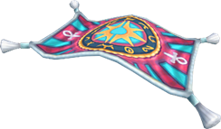
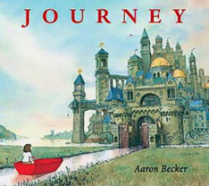
As Scientists we will…
National Curriculum | Suggested Activities | Links | Assessment
observe and describe weather associated with the seasons. be able to gather data to answer a question. be able to observe and describe how the day length varies. Identify, name, draw and label basic parts of the human body. Know which part of the body is associated with each sense. Be able to describe and compare animals. | Seasons​ Animals including humans Go outside and observe the weather, discuss the months of the year and the typical weather. Discuss the Journey books and the weather in the different stories. Record the outside temperature and make a chart. Discuss what we already know. Draw a body and label senses. Bird watch in forest school. Look at school grounds and discuss animal habitats. Visit the village pond. Listen to and take part in ‘Now Press Play’ story about seasons. | Maths ICT Art | Pictures and labelling Through spoken word- questions and answers
Stunning Start
Play the parachute game..
Talk about ourselves and introduce new children and allocate a buddy.
Discuss the school holidays and what you did and where you went.
Discuss where you would go on your magic carpet.
As readers we will...
Read
Journey
Quest
Return
Spoken Word
Listen to and discuss stories
Compose a sentence orally
Read aloud their writing to the teacher/class
Ask simple questions
As Respectful Citizens we will…
Discuss the class/school rules and rewards.
Explore how to make healthy choices
Explore how we manage our feelings
Learn about personal hygiene.
Learn about Christians and what they believe in.
A Journey
As authors and communicators we will…
Reading | Writing | Links | Assessment
Apply phonic knowledge and skills to decode words. Read common exception words Develop pleasure in reading, motivation to read, vocabulary and understanding by discussing word meanings, linking new meanings to those already known Answer questions in discussion with the teacher and make simple inferences | Taught to write sentences Apply phonic knowledge to writing. Consolidate capital letters, full stops, exclamation marks, finger spaces, speech bubbles and bullet points. What might your own story about a ‘Journey’ include? Make a word bank that includes words you could use to describe the people, places and events in the story. | ICT | Self/peer assessment Finished piece of writing.
Fantastic Finish
To go on an expedition around the village
Trips/Fantastic Finish -
Visit to Bredgar and Wormshill railway.
French
Learn basic vocabulary.
Learn to count to 10
Learn to say ‘How are you’ and answer
‘How I feel’
Talk about my family.

Slide 2
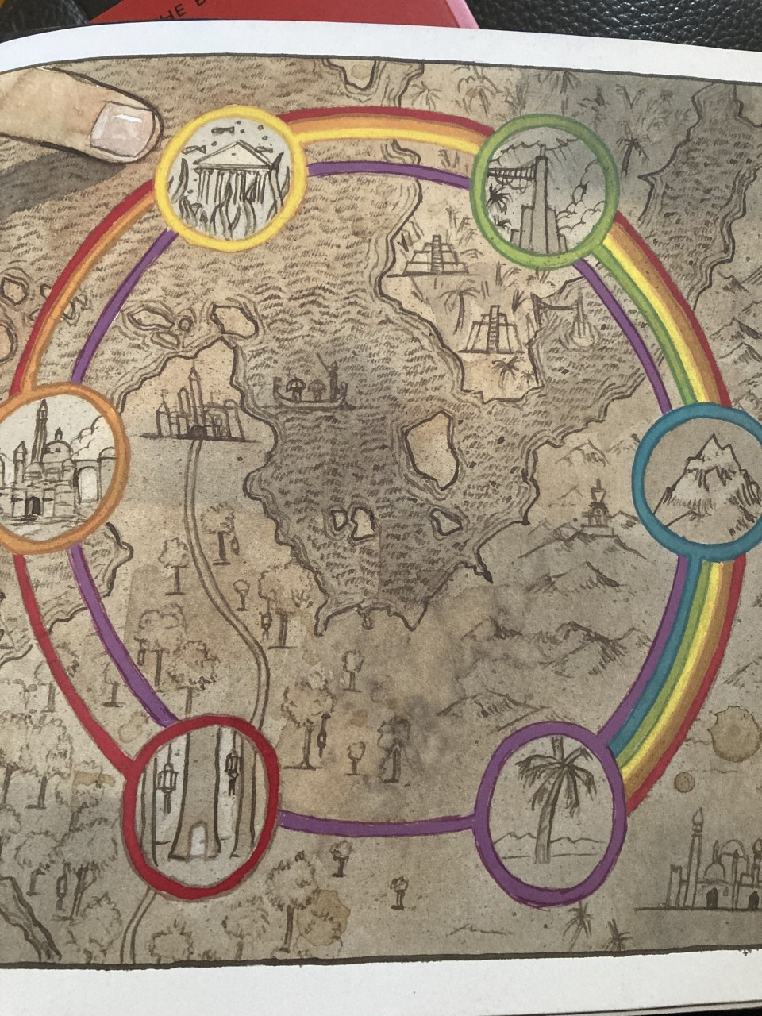
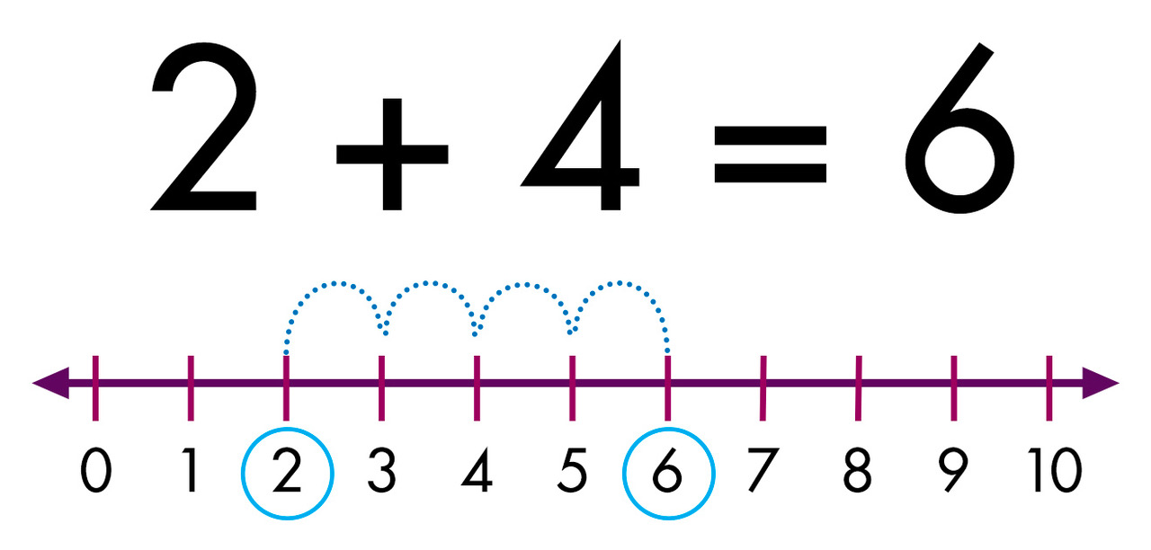
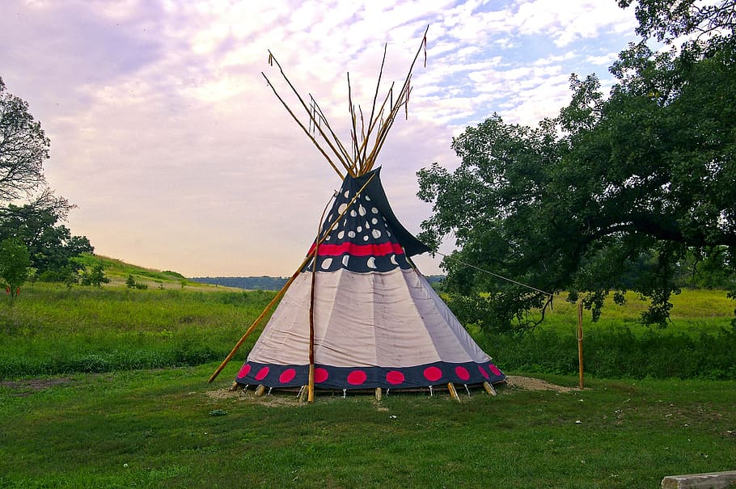
As Geographers we will…
National Curriculum | Suggested Activities | Links | Assessment
Mapping the World​ Climate and weather​ | Introduce maps/atlases/globes Share satellite photos Locate and label where polar climates, equatorial climates and desert climates are found. Define the word ‘climate' and ’‘weather‘ Define the physical features of each climates. Discuss different types of weather and the symbols that represent it. | Art Lit IT | Ongoing, class based assessment
As Artists we will…
National Curriculum | Suggested Activities | Link | Assessment
Pupils should be taught: ▪ to use a range of materials creatively. To use drawing, painting and sculpture to develop and share their ideas. ▪To develop a wide range of art and design techniques in using colour, pattern, texture, line, shape, form and space▪ about the work of a range of artists. | Portraits and photography Look at two famous Italian painters of portraits from the Renaissance period. Discuss What is meant by the phrase ‘perfecting your art’? Copy the style of Warhol to create a portrait of a famous person. Look at photographs of portraits. | Sci | Self/peer assessment
As technicians we will…
National Curriculum | Suggested Activities | Links | Assessment
Use of technology beyond school. | On-line Safety unit. Technology outside school unit. | PSHE | Peer-evaluation, using the specified success criteria
As mathematicians we will…
National Curriculum | Suggested Activities | Assessment
Place value Number | Sorting objects Counting objects Represent objects Count forwards Count backwards Count one more/one less Introduce >, < and = Find the difference Compare statements Ordinal numbers Introduce a number line. Part-whole model Number bonds to 10 Addition Subtraction | Assessment paper at the start of the unit and then again at the end Ongoing class-based assessment
PE
National Curriculum | Suggested Activities | Link | Assessment
Target Forest school. | Ball skills Aim at different targets Learn to play Python and bean bag bocce. Animal habitats Forest Art Reinforce Forest school rules Make a 3d structure | Sci Art PSHE | Self/peer assessment Team work

